Slide 1
COMP3050 Cloud Computing Technology

Slide 2
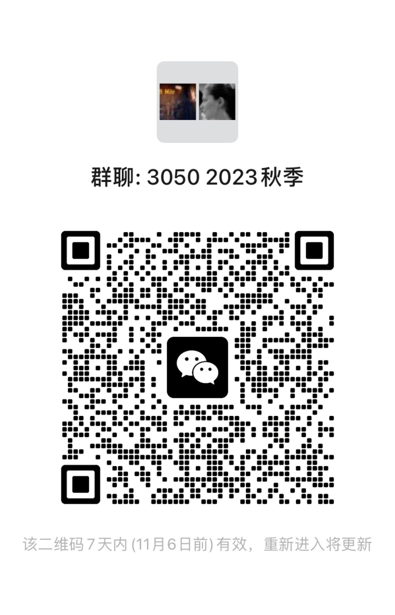
Learning management tools we will use this semester
Communication
WeChat group
Lecture materials and assignment submission
Blackboard - https://bb.hitsz.edu.cn/
Please make sure that you have access to this platform

Slide 3

Contact information
Office: L1503
Office hours: by appointment
Lecturer: Dr Joanna Siebert
WeChat: JoannaSiebert
Class meets @T3501 Wednesdays and Fridays at 2pm

Slide 4

Introduction to the course design

Slide 5
Course Objectives
Understand the origin, concept, principle and implementation technology of cloud computing,
Understand the main products and tools that support cloud computing
Master technical principles and application methods of cloud computing
Understand the main research hotspots and applications of cloud computing
Apply cloud computing technology to solve problems of cloud users

Slide 6
Course Objectives
Understand the origin, concept, principle and implementation technology of cloud computing,
Understand the main products and tools that support cloud computing
Master technical principles and application methods of cloud computing
Understand the main research hotspots and applications of cloud computing
Apply cloud computing technology to solve problems of cloud users

Slide 7
Topics
Cloud Computing Overview
Cloud service models
Cloud users
Cloud Computing Architecture and Standardization
Main supporting technologies of cloud computing
Application of public cloud platform
Private cloud platform construction
Problems with cloud computing
Application domains of cloud computing

Slide 8
Assessment
10% - Continuous assessment and two graded homework assignments
30% - Case study
60% - Report

Slide 9
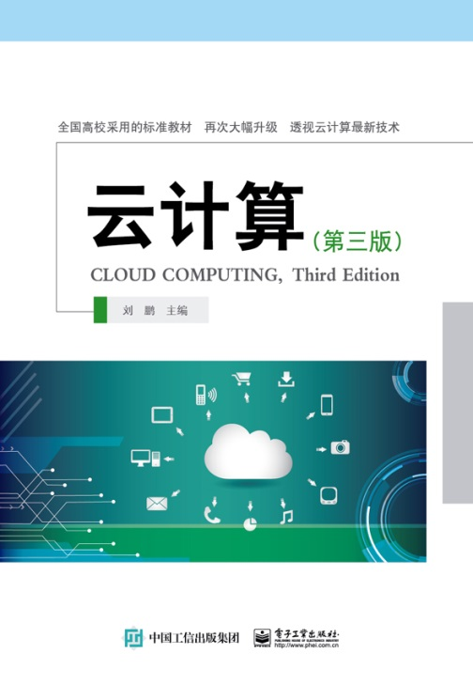
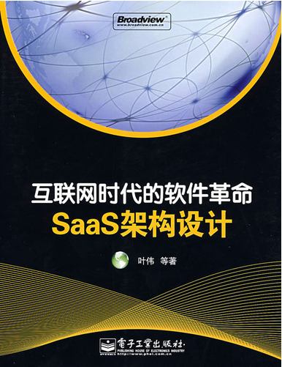
Textbooks
Reference books:
刘鹏，云计算，电子工业出版社，2011年
叶伟等，互联网时代的软件革命—SaaS架构设计，电子工业出版社，2009

Slide 10
Please contact me
if you have any concerns about this subject or require special assistance:
approach me after the lecture
contact me on WeChat
or schedule a meeting in my office

